Slide 1
November 2018
ROS – 教程 1.4
Gazebo仿真器
读取传感器数据
漫游机器人
Huican Lin
huicanlin@gmail.com

Slide 2
Simulators
在仿真中，我们可以根据需求建立真实场景的模型;
传感器和执行器可以被建模为理想设备，或者包含不同程度的失真、错误和意外故障；
控制算法的自动测试通常需要模拟机器人，因为测试中的算法需要能够体验其动作的结果；
由于ROS的消息接口的隔离性，无论是控制真实机器人还是模拟机器人，绝大多数机器人的软件图形都可以相同地运行
(C)2016 Roi Yehoshua

Slide 3
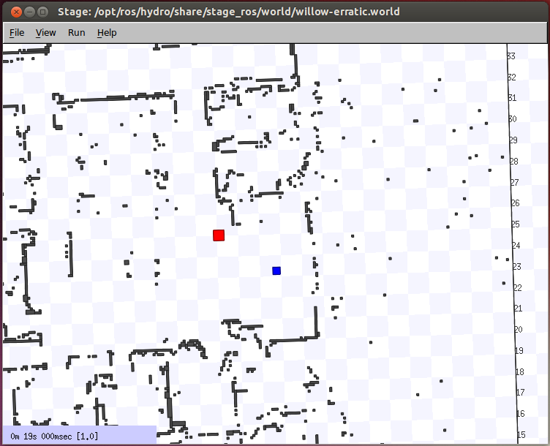
ROS Stage Simulator
参考链接：http://wiki.ros.org/simulator_stage
一个2D仿真器，提供一个虚拟世界，包含移动机器人以及机器人感知和操纵的各种对象。
(C)2016 Roi Yehoshua

Slide 4
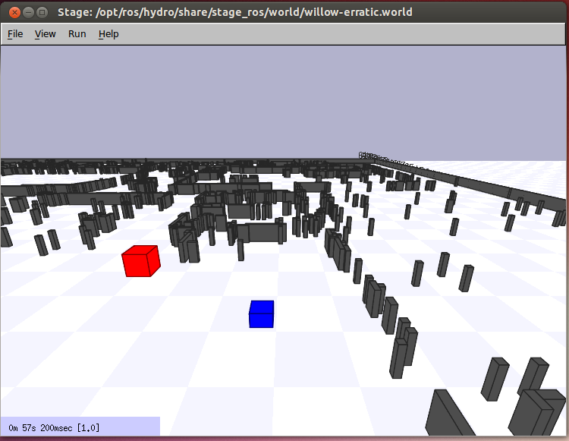
ROS Stage Simulator
在机器人的透视图中
(C)2016 Roi Yehoshua

Slide 5

Gazebo
多机器人仿真器；
像Stage一样，它能够模拟机器人，传感器和物体，并且在3D模式下也是如此；
包括精确的刚体物理模拟，并生成真实的传感器反馈；
允许设计用于操作物理机器人的代码在人工环境中执行
Gazebo正在开源机器人基金会（ Open Source Robotics Foundation, OSRF ）积极开发。
(C)2016 Roi Yehoshua

Slide 6
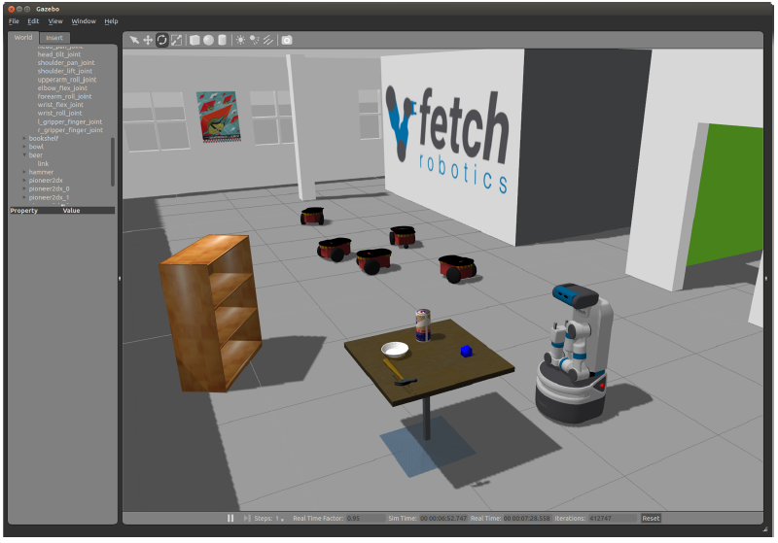
Gazebo
Gazebo Demo
(C)2016 Roi Yehoshua

Slide 7
Gazebo
ROS Indigo 预装Gazebo V2.2，ROS K*预装Gazebo V？
Gazebo 主页： http://gazebosim.org/
Gazebo 教程：- http://gazebosim.org/tutorials
(C)2016 Roi Yehoshua

Slide 8
Gazebo 架构
Gazebo consists of two processes:
服务器: 运行物理循环和生成传感器数据
执行: gzserver
库: Physics, Sensors, Rendering, Transport
客户端: 提供用户接口和仿真器可视化.
执行: gzclient
库: Transport, Rendering, GUI
(C)2016 Roi Yehoshua

Slide 9
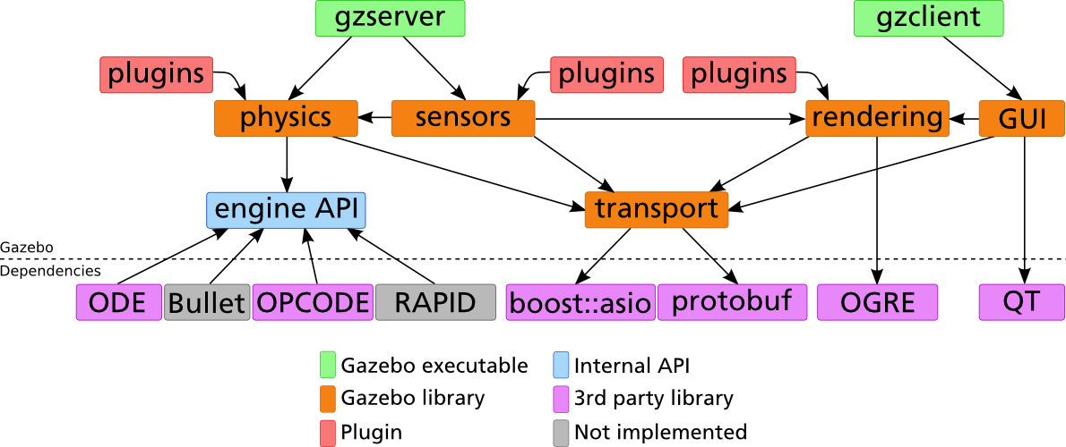
Gazebo 架构
(C)2016 Roi Yehoshua

Slide 10
Running Gazebo from ROS
通过如下命令启动Gazebo:
注意: 当第一次启动Gazebo时，可能需要几分钟时间更新模型数据库
$ rosrun gazebo_ros gazebo
(C)2016 Roi Yehoshua

Slide 11
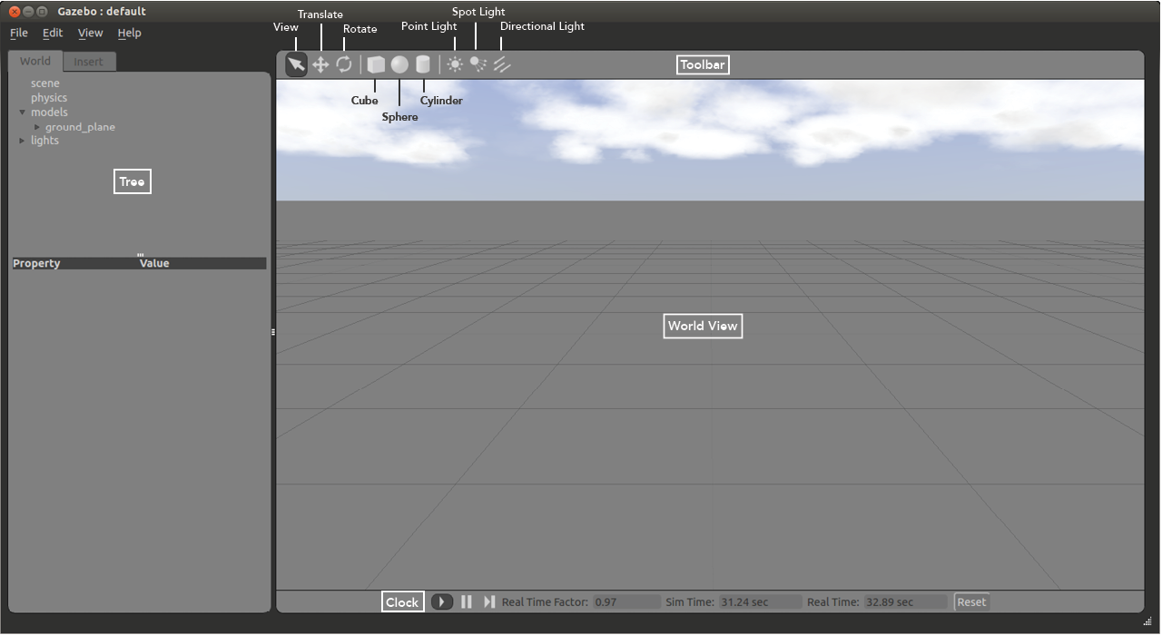
Gazebo 用户接口
(C)2016 Roi Yehoshua

Slide 12
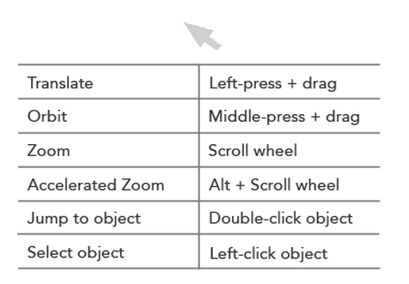
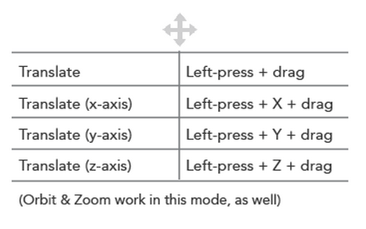
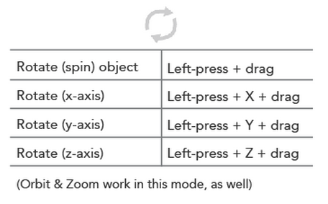
世界视图
世界视图显示世界及其中的所有模型；
在这里，您可以添加，操作和删除模型；
您可以在工具栏左侧的视图的“查看”，“平移”和“旋转”模式之间切换。
View Mode
Translate Mode
Rotate Mode
(C)2016 Roi Yehoshua

Slide 13
增加模型
通过如下步骤增加模型到世界:
在左侧的“插入”选项卡中左键单击所需的模型；
将光标移动到世界视图中所需位置；
再次单击鼠标左键以释放；
使用“平移”和“旋转”模式可以更精确地定向模型；
(C)2016 Roi Yehoshua

Slide 14
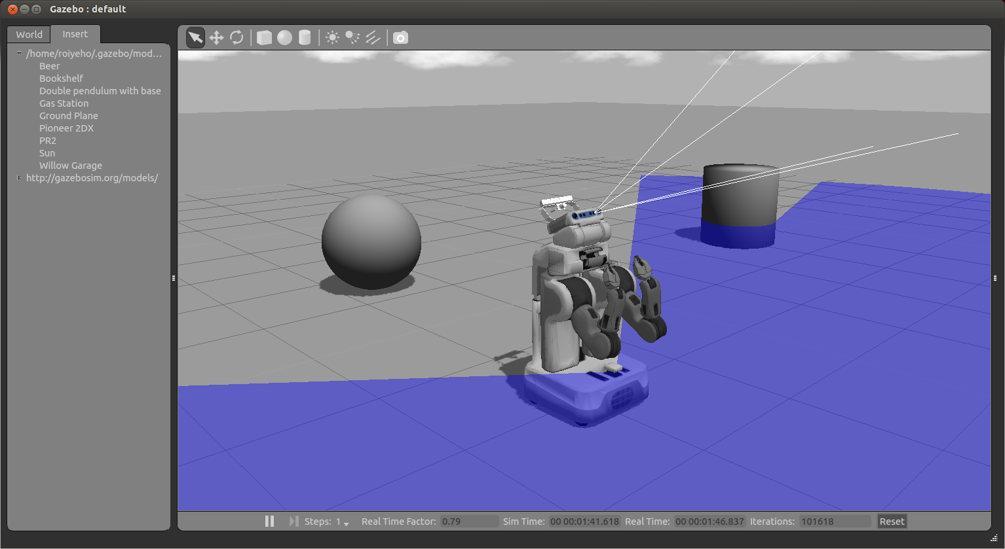
插入PR2 机器人
(C)2016 Roi Yehoshua

Slide 15
模型项
“世界”选项卡中的模型项包含所有模型及其链接的列表
右键单击“模型”部分中的模型可为您提供三个选项:
Move to –将视图移动到该模型的正前方；
Follow
View –允许您查看模型的不同方面，例如线框，碰撞，关节;
Delete –删除模型；
(C)2016 Roi Yehoshua

Slide 16
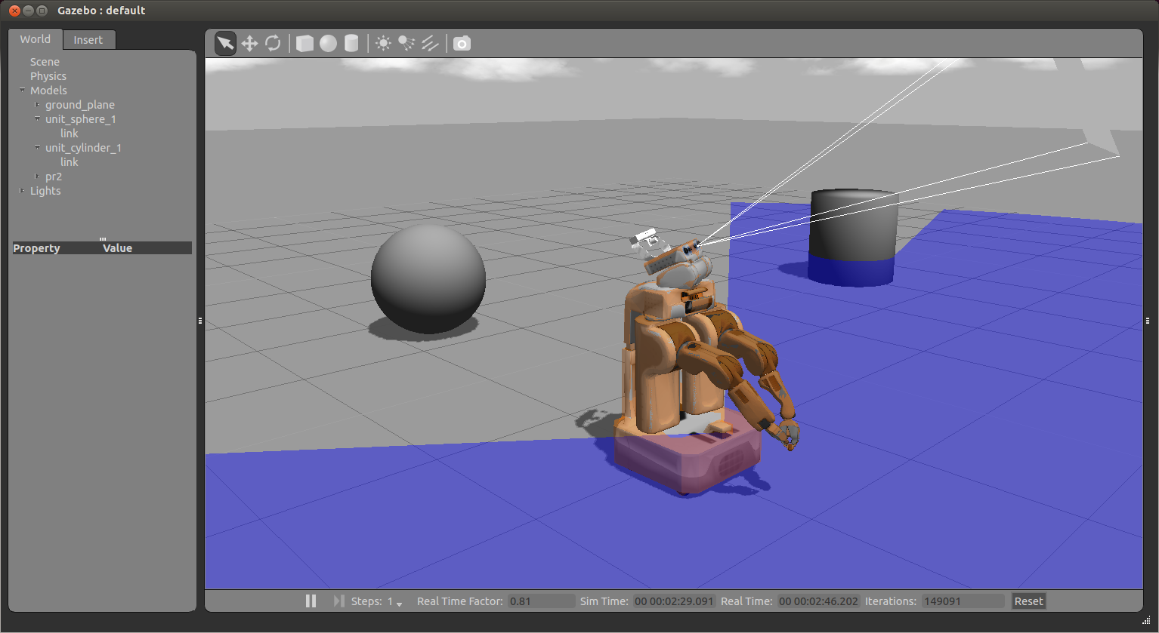
碰撞视图
(C)2016 Roi Yehoshua

Slide 17
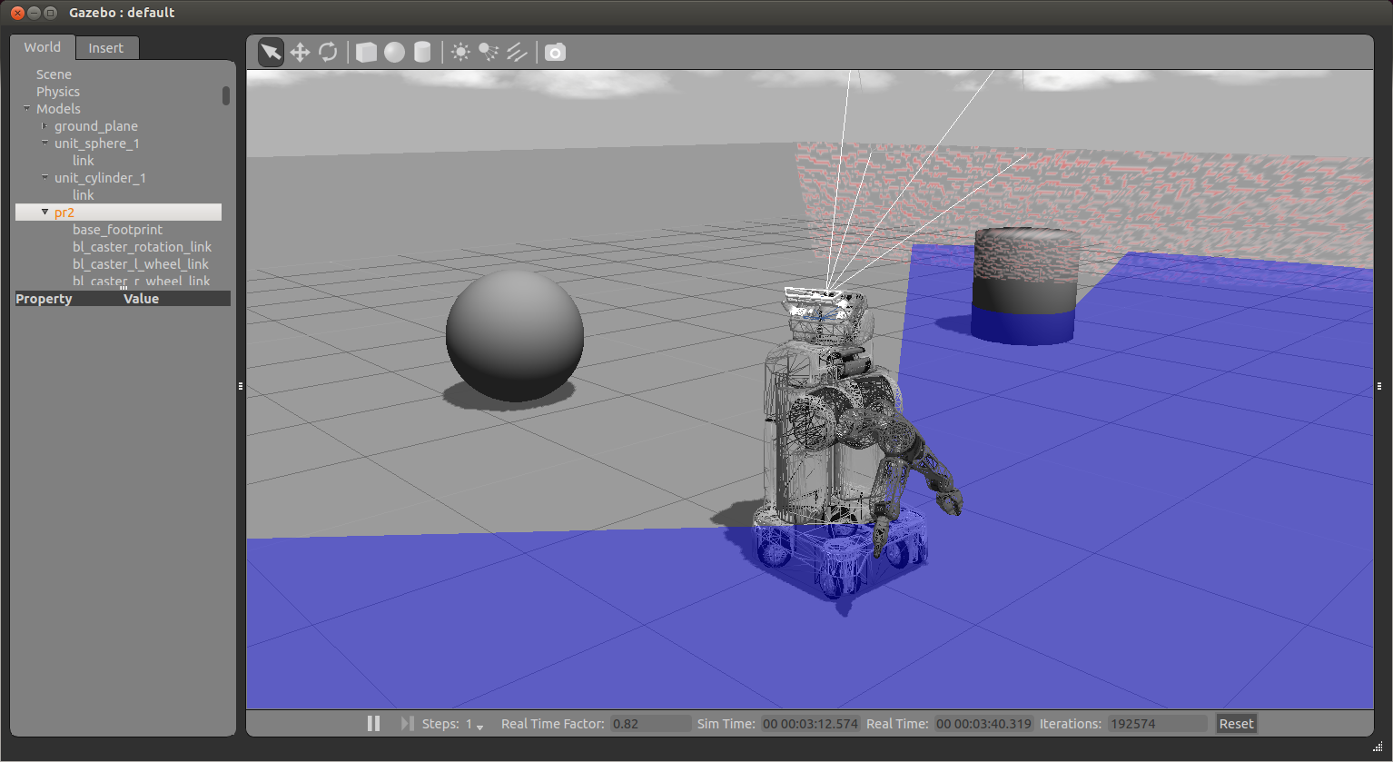
线框视图
(C)2016 Roi Yehoshua

Slide 18
时钟（ Clock ）
您可以使用时钟在仿真过程中开始、暂停和继续仿真；
它位于世界视图的底部：
Real Time Factor: Displays how fast or slow the simulation is running in comparison to real time
实时因子(Real Time Factor)：显示与实时运行速度相比仿真运行的快慢程度。
小于1.0的因子表示仿真运行速度比实时慢;
大于1.0表示比实时更快。
(C)2016 Roi Yehoshua

Slide 19
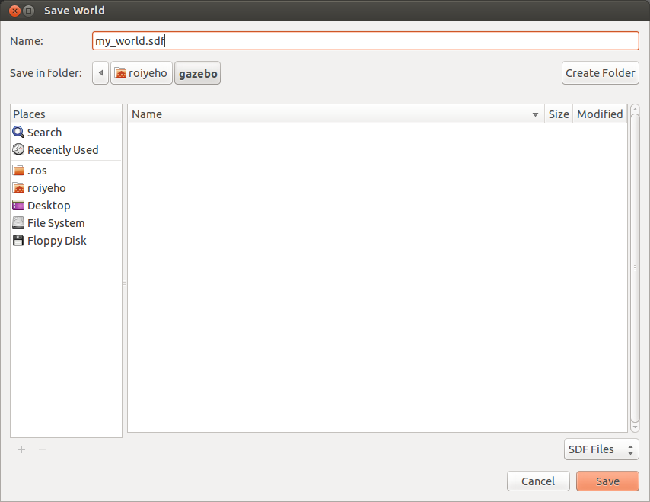
保存仿真世界
一旦你对创建的仿真世界感到满意，就可以通过File-> Save As菜单保存它；
输入my_world.sdf作为文件名，然后单击“OK”
(C)2016 Roi Yehoshua

Slide 20
载入仿真世界
可以在命令行上加载已保存的世界：
文件名必须位于当前工作目录中，或者您必须指定完整路径。
$ gazebo my_world.sdf
(C)2016 Roi Yehoshua

Slide 21
仿真世界描述文件
仿真世界描述文件包含仿真中的所有元素，包括机器人、灯光、传感器和静态对象；
此文件使用SDF格式，并具有.world扩展名；
Gazebo服务器（gzserver）读取此文件以生成并填充世界。
(C)2016 Roi Yehoshua

Slide 22
仿真世界文件示例
Gazebo附带了许多仿真世界示例；
仿真世界文件位于Gazebo资源路径的/worlds目录中：
典型的路径是/usr/share/gazebo-2.2
在gazebo_ros包中有内置的启动文件，可以加载其中一些仿真世界文件；
例如，要启动willowgarage_world，输入:
$ roslaunch gazebo_ros willowgarage_world.launch
(C)2016 Roi Yehoshua

Slide 23
willowgarage.world
<?xml version="1.0" ?>
<sdf version="1.4">
<world name="default">
<include>
<uri>model://ground_plane</uri>
</include>
<include>
<uri>model://sun</uri>
</include>
<include>
<uri>model://willowgarage</uri>
</include>
</world>
</sdf>
在这个仿真世界文件片段中，您可以看到引用了三个模型；
在您当地的Gazebo模型数据库中搜索这三个模型；
如果本地数据库找不到，它们将自动从Gazebo的在线数据库中取出。
(C)2016 Roi Yehoshua

Slide 24
启动仿真世界文件
在gazebo_ros包中有内置的启动文件，可以加载其中一些仿真世界文件；
例如，启动willowgarage_world输入:
$ roslaunch gazebo_ros willowgarage_world.launch
(C)2016 Roi Yehoshua

Slide 25
willowgarage_world.launch
<launch>
<!-- We resume the logic in empty_world.launch, changing only the name of the world to be launched -->
<include file="$(find gazebo_ros)/launch/empty_world.launch">
<arg name="world_name" value="worlds/willowgarage.world"/> <!-- Note: the world_name is with respect to GAZEBO_RESOURCE_PATH environmental variable -->
<arg name="paused" value="false"/>
<arg name="use_sim_time" value="true"/>
<arg name="gui" value="true"/>
<arg name="headless" value="false"/>
<arg name="debug" value="false"/>
</include>
</launch>
This launch file inherits most of the necessary functionality from empty_world.launch
The only parameter we need to change is the world_name parameter, substituting the empty.world world file with willowgarage.world
The other arguments are simply set to their default values
(C)2016 Roi Yehoshua

Slide 26
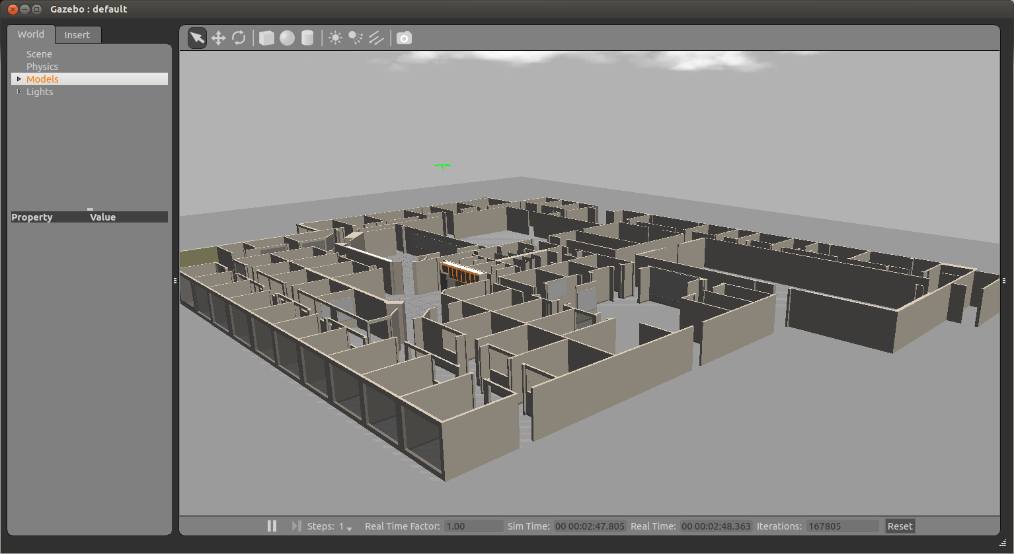
Willow Garage World
(C)2016 Roi Yehoshua

Slide 27
Model Files
A model file uses the same SDF format as world files, but contains only a single <model> tag
Once a model file is created, it can be included in a world file using the following SDF syntax:
You can also include any model from the online database and the necessary content will be downloaded at runtime
<include filename="model_file_name"/>
(C)2016 Roi Yehoshua

Slide 28
willowgarage Model SDF File
<?xml version="1.0" ?>
<sdf version="1.4">
<model name="willowgarage">
<static>true</static>
<pose>-20 -20 0 0 0 0</pose>
<link name="walls">
<collision name="collision">
<geometry>
<mesh>
<uri>model://willowgarage/meshes/willowgarage_collision.dae</uri>
</mesh>
</geometry>
</collision>
<visual name="visual">
<geometry>
<mesh>
<uri>model://willowgarage/meshes/willowgarage_visual.dae</uri>
</mesh>
</geometry>
<cast_shadows>false</cast_shadows>
</visual>
</link>
</model>
</sdf>
(C)2016 Roi Yehoshua

Slide 29
Components of Models
Links: A link contains the physical properties of one body of the model. This can be a wheel, or a link in a joint chain.
Each link may contain many collision, visual and sensor elements
Collision: A collision element encapsulates a geometry that is used to collision checking.
This can be a simple shape (which is preferred), or a triangle mesh (which consumes greater resources).
Visual: A visual element is used to visualize parts of a link.
Inertial: The inertial element describes the dynamic properties of the link, such as mass and rotational inertia matrix.
Sensor: A sensor collects data from the world for use in plugins.
Joints: A joint connects two links.
A parent and child relationship is established along with other parameters such as axis of rotation, and joint limits.
Plugins: A shared library created by a 3D party to control a model.
(C)2016 Roi Yehoshua

Slide 30
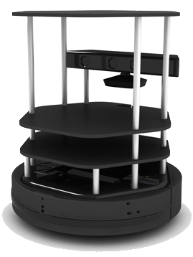
Meet TurtleBot
http://wiki.ros.org/Robots/TurtleBot
A minimalist platform for ROS-based mobile robotics education and prototyping
Has a small differential-drive mobile base
Atop this base is a stack of laser-cut “shelves” that provide space to hold a netbook computer and depth camera and other devices
Does not have a laser scanner
Despite this, mapping and navigation can work quite well for indoor spaces
(C)2016 Roi Yehoshua

Slide 31
Turtlebot Simulation
To install Turtlebot simulation stack type:
To launch a simple world with a Turtlebot, type:
$ sudo apt-get install ros-indigo-turtlebot-gazebo ros-indigo-turtlebot-apps ros-indigo-turtlebot-rviz-launchers
$ roslaunch turtlebot_gazebo turtlebot_world.launch
(C)2016 Roi Yehoshua

Slide 32
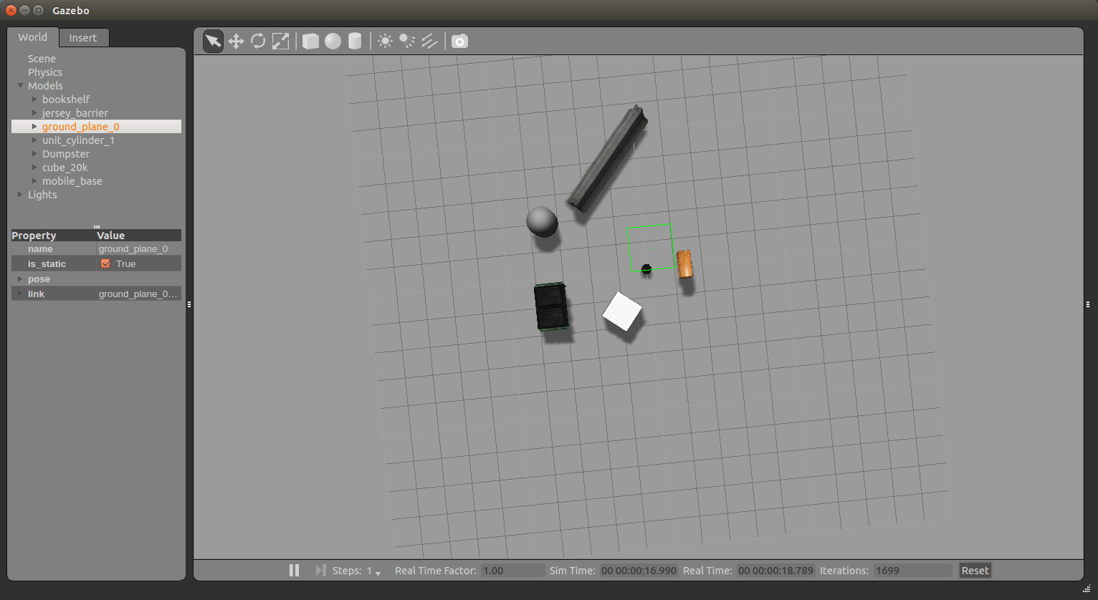
Turtlebot Simulation
(C)2016 Roi Yehoshua

Slide 33
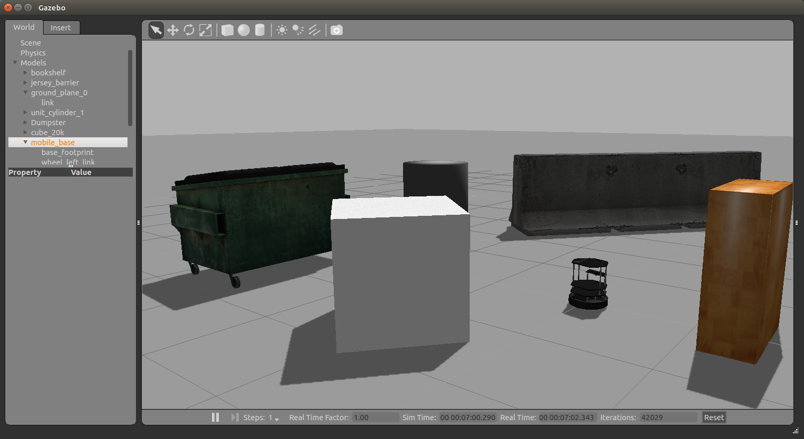
Turtlebot Simulation
(C)2016 Roi Yehoshua

Slide 34
Moving Turtlebot with Teleop
Let’s launch the teleop package so we can move it around the environment
Run the following command:
$ roslaunch turtlebot_teleop keyboard_teleop.launch
(C)2016 Roi Yehoshua

Slide 35
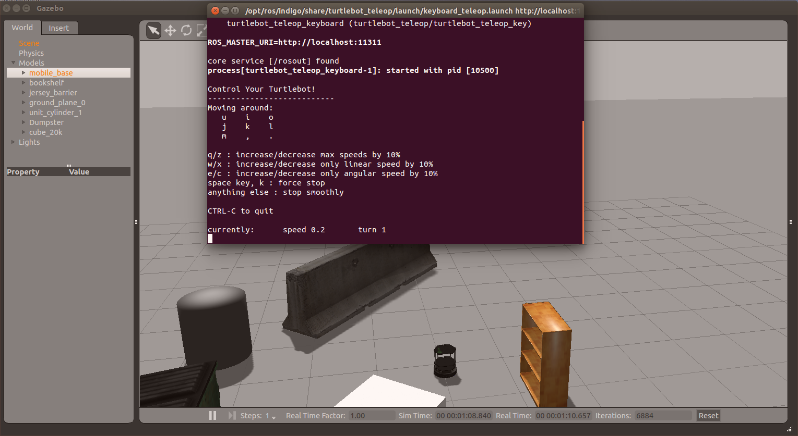
Moving Turtlebot with Teleop
(C)2016 Roi Yehoshua

Slide 36
Laser Scan Data
Laser data is published to the topic /base_scan
The message type that used to send information of the laser is sensor_msgs/LaserScan
You can see the structure of the message using
$ rosmsg show sensor_msgs/LaserScan
(C)2016 Roi Yehoshua

Slide 37
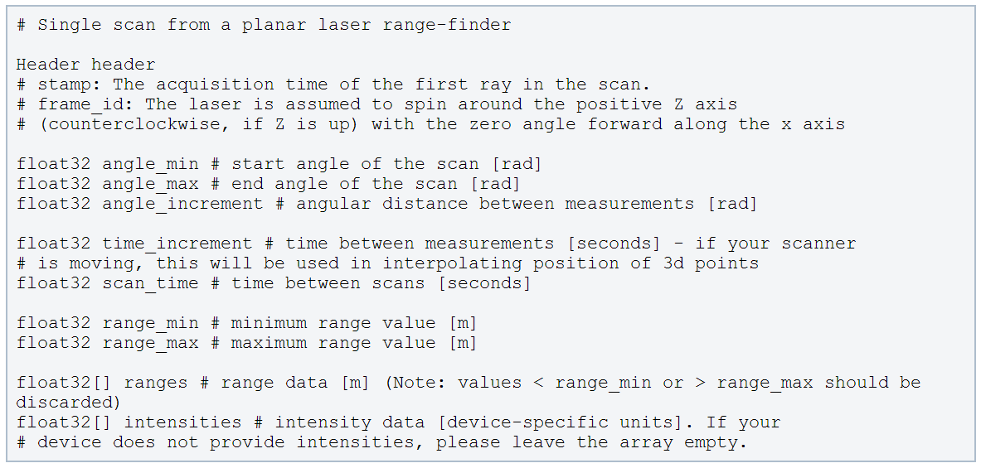
LaserScan Message
http://docs.ros.org/api/sensor_msgs/html/msg/LaserScan.html
(C)2016 Roi Yehoshua

Slide 38
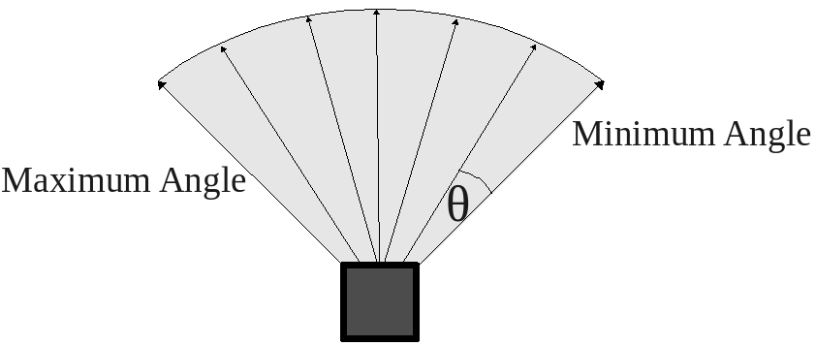
Laser Scanner
(C)2016 Roi Yehoshua

Slide 39
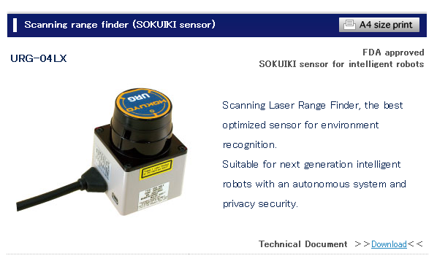
Hokuyo Laser
A common laser sensor used in robotics
http://www.hokuyo-aut.jp/02sensor/07scanner/urg_04lx.html
(C)2016 Roi Yehoshua

Slide 40
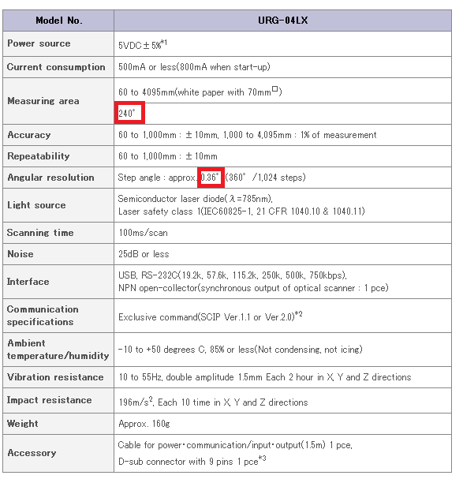
Hokuyo Laser
(C)2016 Roi Yehoshua

Slide 41
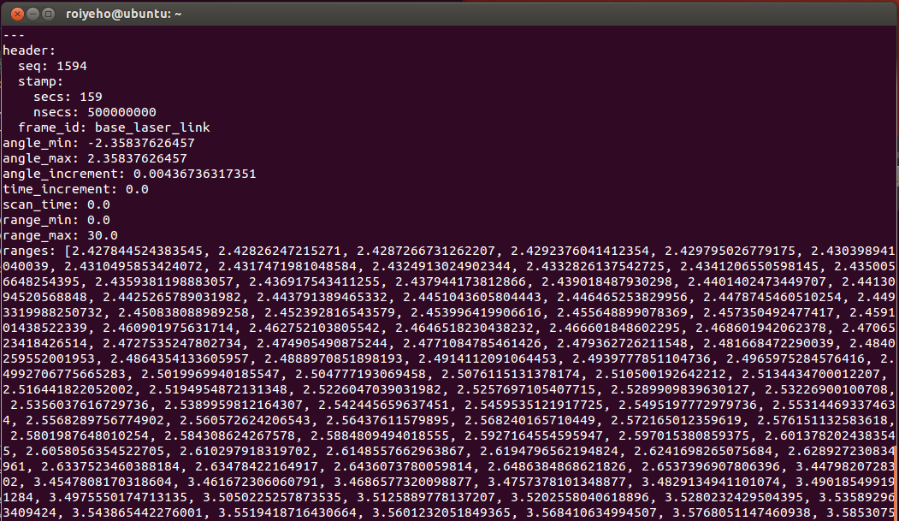
LaserScan Message
Example of a laser scan message from Stage: (rostopic echo /scan –n1)
(C)2016 Roi Yehoshua

Slide 42
Depth Image to Laser Scan
TurtleBot doesn’t have a LIDAR by default
However, the image from its depth camera can be used as a laser scan
The node depthimage_to_laserscan takes a depth image and generates a 2D laser scan based on the provided parameters
This node is run automatically when you run the turtlebot simulation in Gazebo
The output range arrays contain NaNs and +-Infs (when the range is less than range_min or larger than range_max)
Comparisons with NaNs always return false
(C)2016 Roi Yehoshua

Slide 43
Depth Image to Laser Scan
tutrlebot_world.launch
<launch>
...
<!-- Fake laser -->
<node pkg="nodelet" type="nodelet" name="laserscan_nodelet_manager" args="manager"/>
<node pkg="nodelet" type="nodelet" name="depthimage_to_laserscan"
args="load depthimage_to_laserscan/DepthImageToLaserScanNodelet laserscan_nodelet_manager">
<param name="scan_height" value="10"/>
<param name="output_frame_id" value="/camera_depth_frame"/>
<param name="range_min" value="0.45"/>
<remap from="image" to="/camera/depth/image_raw"/>
<remap from="scan" to="/scan"/>
</node>
</launch>
(C)2016 Roi Yehoshua

Slide 44
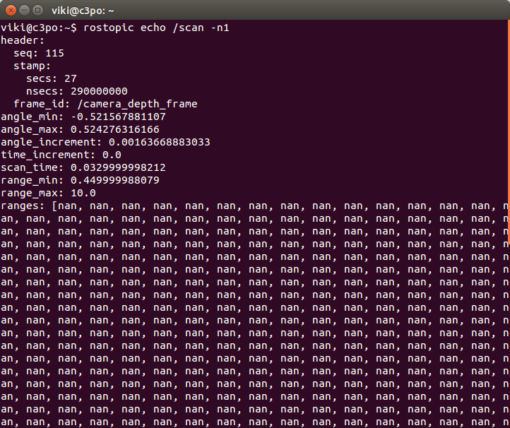
LaserScan Message
Example of a laser scan message from TurtleBot: (rostopic echo /scan –n1)
(C)2016 Roi Yehoshua

Slide 45
Wander-bot
We’ll now put all the concepts we’ve learned so far together to create a robot that can wander around its environment
This might not sound terribly earth-shattering, but such a robot is actually capable of doing meaningful work: there is an entire class of tasks that are accomplished by driving across the environment
For example, many vacuuming or other floor-cleaning tasks can be accomplished by cleverly algorithms where the robot, carrying its cleaning tool, traverses its environment somewhat randomly
The robot will eventually drive over all parts of the environment, completing its task
(C)2016 Roi Yehoshua

Slide 46
A Stopper Node
We’ll start with a node called stopper that will make the robot move forward until it detects an obstacle in front of it
We will use the laser sensor to detect the obstacle
Create a new package called wander_bot
$ cd ~/catkin_ws/src
$ catkin_create_pkg wander_bot std_msgs rospy roscpp
(C)2016 Roi Yehoshua

Slide 47
A Stopper Node
In Eclipse under the package’s src directory add a new class named Stopper
This will create Stopper.h and Stopper.cpp
Add a source file run_stopper.cpp
This will contain the main function
(C)2016 Roi Yehoshua

Slide 48
Stopper.h
#include "ros/ros.h"
#include "sensor_msgs/LaserScan.h"
class Stopper {
public:
// Tunable parameters
const static double FORWARD_SPEED = 0.5;
const static double MIN_SCAN_ANGLE = -30.0/180*M_PI;
const static double MAX_SCAN_ANGLE = +30.0/180*M_PI;
const static float MIN_DIST_FROM_OBSTACLE = 0.5; // Should be smaller than sensor_msgs::LaserScan::range_max
Stopper();
void startMoving();
private:
ros::NodeHandle node;
ros::Publisher commandPub; // Publisher to the robot's velocity command topic
ros::Subscriber laserSub; // Subscriber to the robot's laser scan topic
bool keepMoving; // Indicates whether the robot should continue moving
void moveForward();
void scanCallback(const sensor_msgs::LaserScan::ConstPtr& scan);
};
(C)2016 Roi Yehoshua

Slide 49
Stopper.cpp (1)
#include "Stopper.h"
#include "geometry_msgs/Twist.h"
Stopper::Stopper()
{
keepMoving = true;
// Advertise a new publisher for the robot's velocity command topic
commandPub = node.advertise<geometry_msgs::Twist>(" /cmd_vel_mux/input/teleop", 10);
// Subscribe to the simulated robot's laser scan topic
laserSub = node.subscribe("scan", 1, &Stopper::scanCallback, this);
}
// Send a velocity command
void Stopper::moveForward() {
geometry_msgs::Twist msg; // The default constructor will set all commands to 0
msg.linear.x = FORWARD_SPEED_MPS;
commandPub.publish(msg);
}
(C)2016 Roi Yehoshua

Slide 50
Stopper.cpp (2)
// Process the incoming laser scan message
void Stopper::scanCallback(const sensor_msgs::LaserScan::ConstPtr& scan)
{
bool isObstacleInFront = false;
// Find the closest range between the defined minimum and maximum angles
int minIndex = ceil((MIN_SCAN_ANGLE - scan->angle_min) / scan->angle_increment);
int maxIndex = floor((MAX_SCAN_ANGLE - scan->angle_min) / scan->angle_increment);
for (int currIndex = minIndex + 1; currIndex <= maxIndex; currIndex++) {
if (scan->ranges[currIndex] < MIN_DIST_FROM_OBSTACLE) {
isObstacleInFront = true;
break;
}
}
if (isObstacleInFront) {
ROS_INFO("Stop!");
keepMoving = false;
}
}
(C)2016 Roi Yehoshua

Slide 51
Stopper.cpp (3)
void Stopper::startMoving()
{
ros::Rate rate(10);
ROS_INFO("Start moving");
// Keep spinning loop until user presses Ctrl+C or the robot got too close to an obstacle
while (ros::ok() && keepMoving) {
moveForward();
ros::spinOnce(); // Need to call this function often to allow ROS to process incoming messages
rate.sleep();
}
}
(C)2016 Roi Yehoshua

Slide 52
run_stopper.cpp
#include "Stopper.h"
int main(int argc, char **argv) {
// Initiate new ROS node named "stopper"
ros::init(argc, argv, "stopper");
// Create new stopper object
Stopper stopper;
// Start the movement
stopper.startMoving();
return 0;
};
(C)2016 Roi Yehoshua

Slide 53
CMakeLists.txt
Edit the following lines in CMakeLists.txt:
cmake_minimum_required(VERSION 2.8.3)
project(my_stage)
…
## Declare a cpp executable
add_executable(stopper src/Stopper.cpp src/run_stopper.cpp)
## Specify libraries to link a library or executable target against
target_link_libraries(stopper ${catkin_LIBRARIES})
(C)2016 Roi Yehoshua

Slide 54
Launch File
Launch file for launching both Gazebo and the stopper node:
To run the launch file:
<launch>
<param name="/use_sim_time" value="true" />
<!-- Launch turtle bot world -->
<include file="$(find turtlebot_gazebo)/launch/turtlebot_world.launch"/>
<!-- Launch stopper node -->
<node name="stopper" pkg="wander_bot" type="stopper" output="screen"/>
</launch>
$ roslaunch wander_bot stopper.launch
(C)2016 Roi Yehoshua

Slide 55
ROS Clock
Normally, ROS client libraries use the computer's system clock as the "wall-clock“
When you are running a simulation or playing back logged data, it is often desirable to instead have the system use a simulated clock so that you can have accelerated, slowed, or stepped control over your system's perceived time
To support this, the ROS client libraries can listen to the /clock topic that is used to publish "simulation time“
For that purpose, set the /use_sim_time parameter to true before the node is initialized
(C)2016 Roi Yehoshua

Slide 56
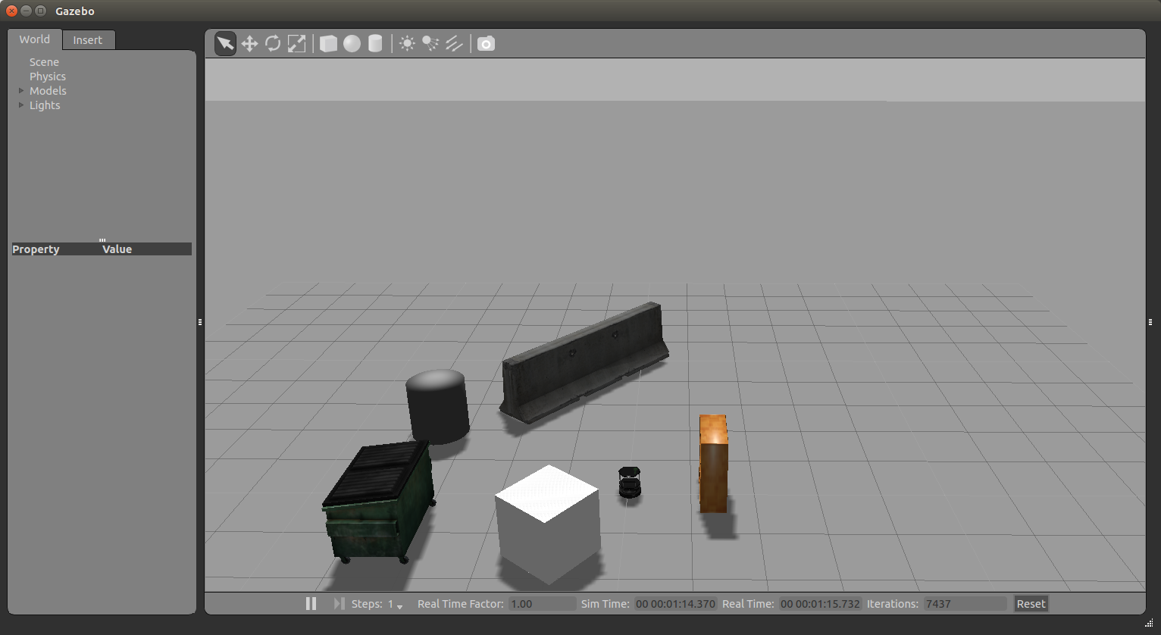
Turtlebot Initial Position
(C)2016 Roi Yehoshua

Slide 57
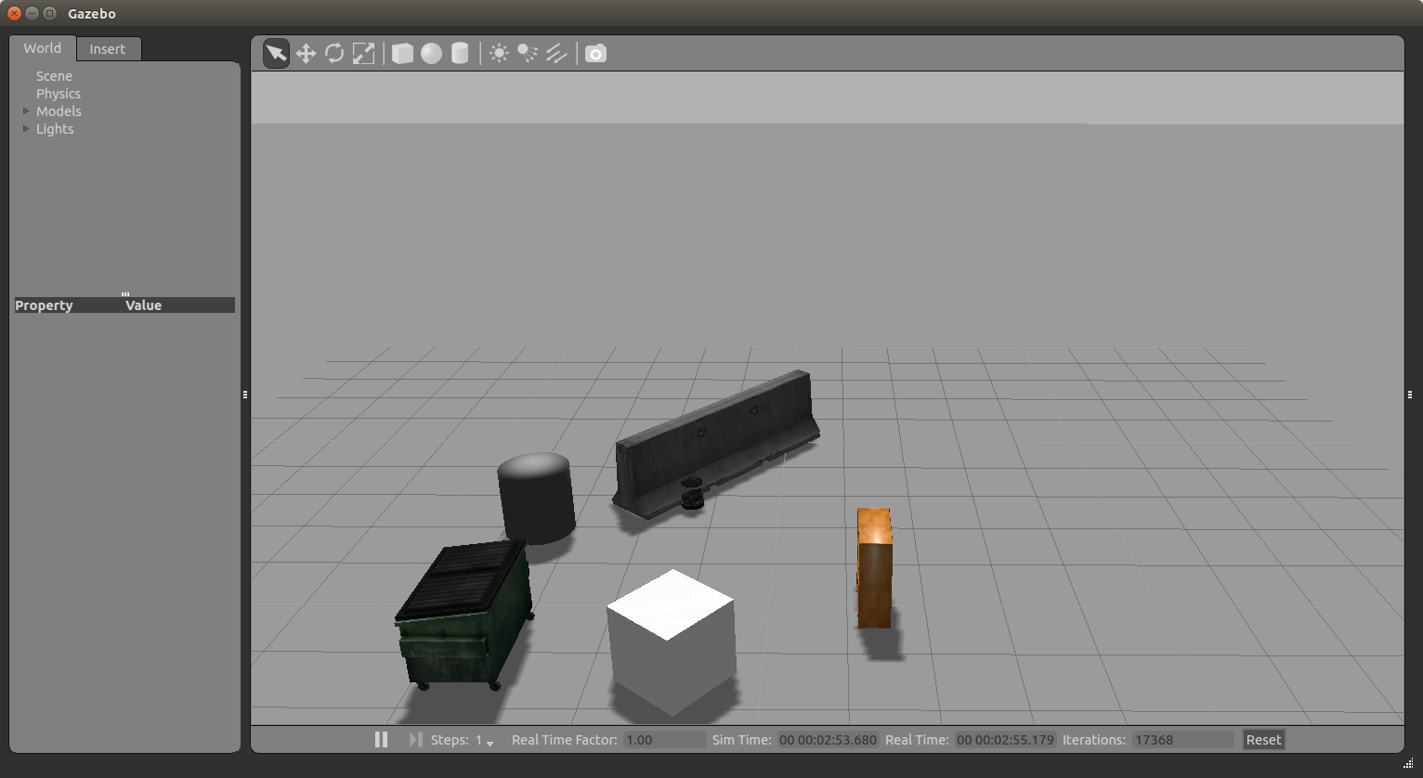
Turtlebot Final Position
(C)2016 Roi Yehoshua

Slide 58
Ex. 4 (For Submission)
Implement a simple walker algorithm much like a Roomba robot vaccum cleaner
The robot should move forward until it reaches an obstacle, then rotate in place until the way ahead is clear, then move forward again and repeat
Bonus: rotate the robot in the direction that is more free from obstacles
(C)2016 Roi Yehoshua

